Slide 1
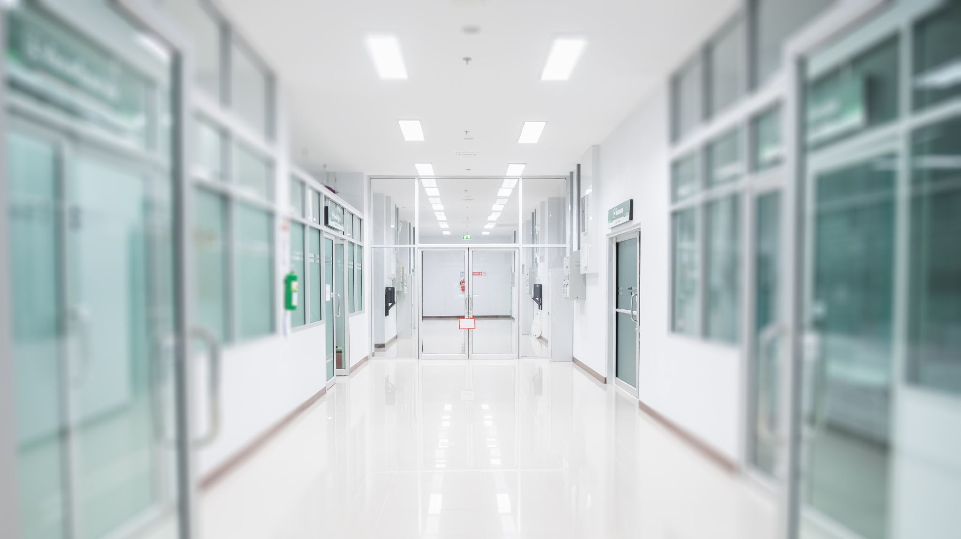
HOSPITAL MANAGEMENT
By: Lola Sánchez, María Rueda, Jaime Soler and Kacper Borysewicz

Slide 2
Index
Introduction -> Description about our Project
Main features
Use Case's
List of requirements
Entity Relationship Diagram (E-R Diagram)
Tables of our project
Mock up
Conclusion

Slide 3
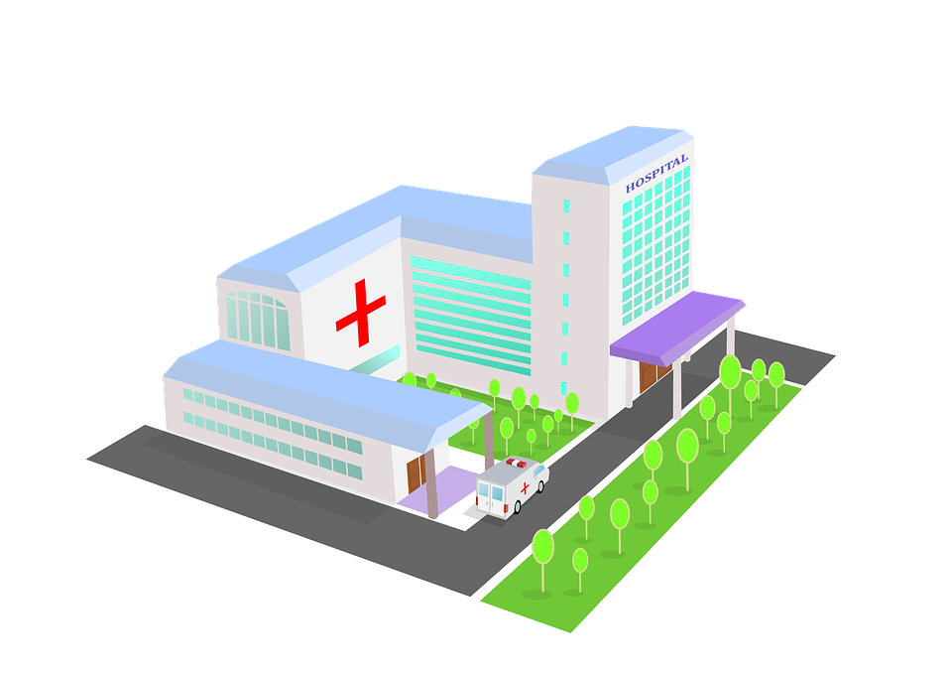

INTRODUCTION
Our project . . .
Control the logistic functions of a hospital
Create relationships between a patient and a doctor, a doctor and a nurse and a nurse with the patient.
Improve the doctor´s and nurse´s job and the access to all the information.

Slide 4


Introduction
Doctors, nurses and patients can register
Involved with the patient during all his stay
Follow a diagnosis and provide them with medicines

Slide 5
USE Cases

Slide 6



USE CASE 1
Input username
Input password
Input data
Input phone number of a close family member
Doctor
Patient
Nurse
Register

Slide 7

USE CASE 2
Doctor
Patient registered
Look at symtoms
Register Disease
Diagnose
the patient

Slide 8
USE CASE 3
Doctor
Use case 2
Call a close family member
Report status to the family of the patient

Slide 9
USE CASE 4
Doctor
Use case 2
Input medicines
Treat
the patient

Slide 10
USE CASE 5
Doctor
Use case 2
Put the final 'results' in the medical history of the patient
Discharge patient

Slide 11
USE CASE 6
Patient
Pay with credit card or cash
Leave hospital

Slide 12
USE CASE 7
Nurse
Register status of the patient ( serve or not serve )
Monitor patient

Slide 13
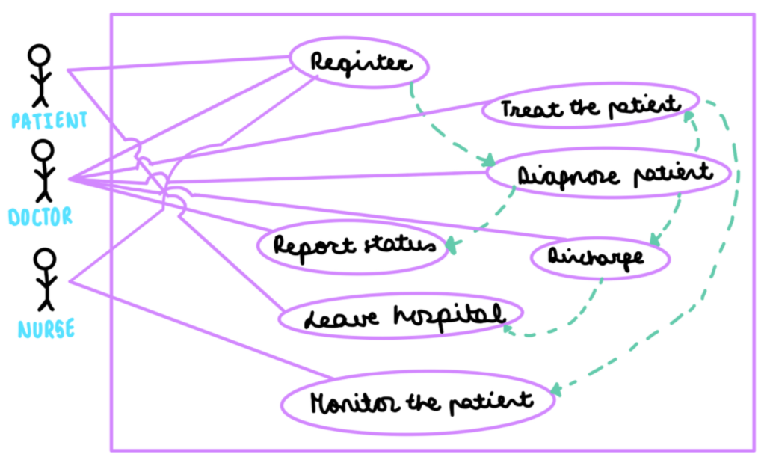
UML USE CASE DIAGRAM

Slide 14

List of requirements
Functional Requirements:
1: Must allow patients to register
2: Must allow doctors to register
3: Must allow patients to stay at hospital for a short or long time
4: Must allow the doctor to update a patient’s status
5: Must allow the doctor to report the status of a patient to his family members
6: Must allow the doctor to discharge the patient
7: Must allow the patient to pay
8: Must allow the nurse to monitor a patient

Slide 15
List of requirements
Non-functional:
1: Must allow the patient to pay with credit card or cash
2: Application must be able to run in a laptop computer
3: Application must support 15 or more doctors and nurses

Slide 16
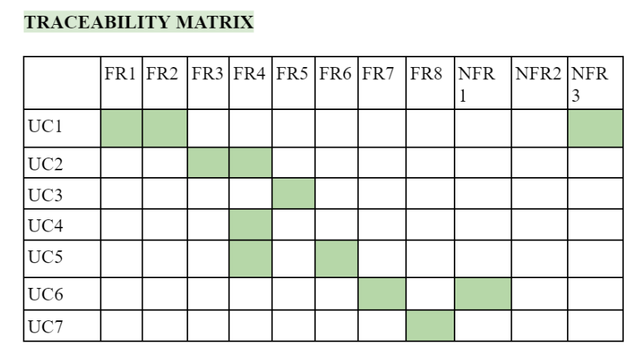


->UC 1:register with a password and a username.
->NFR3:application must support 15 or more doctors and nurses.
->UC 5: discharge a patient and update the medical history
->FR4:must allow the doctor to update a patient's status.

Slide 17
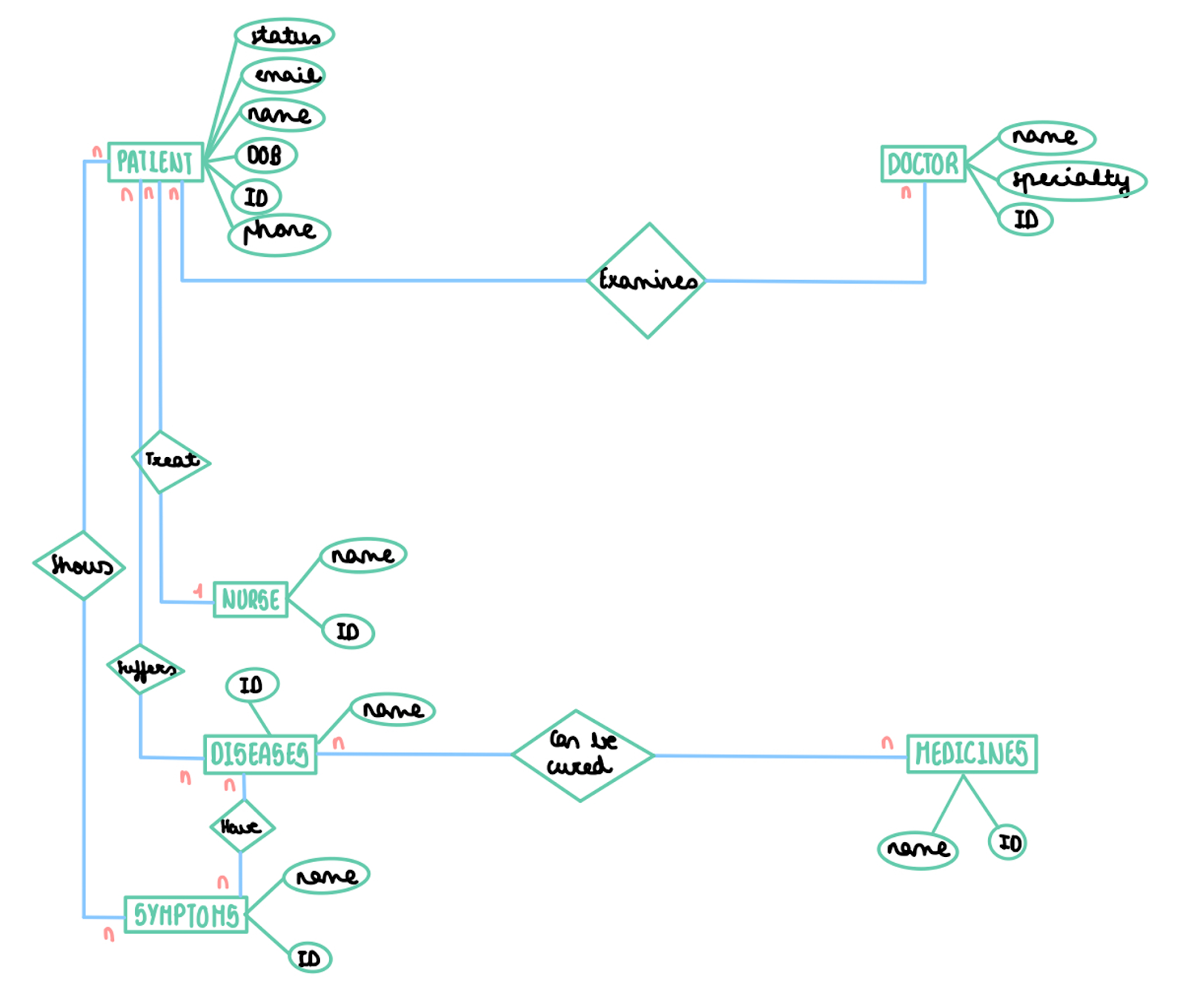
E-R DIAGRAM

Slide 18
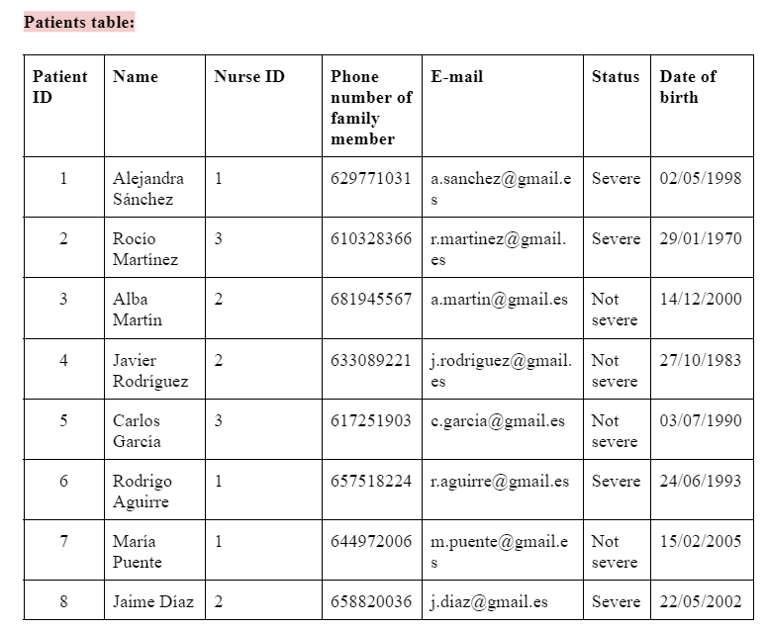
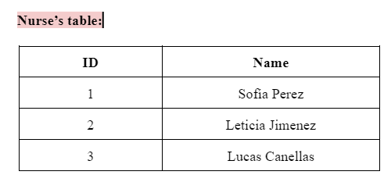

Slide 19
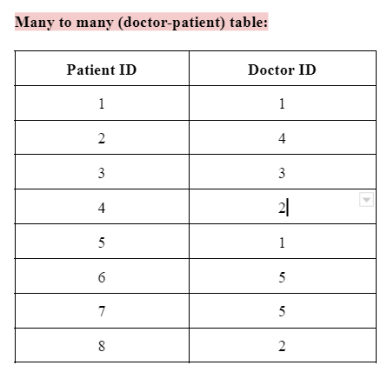
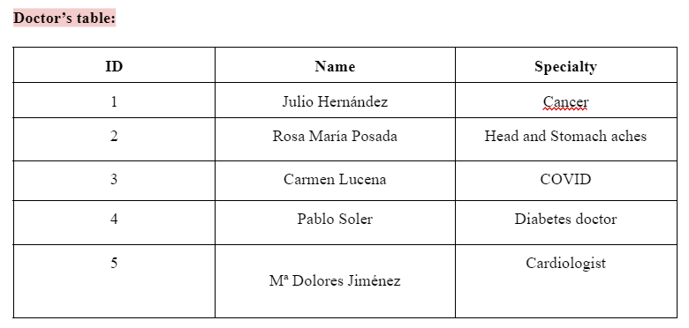

Slide 20
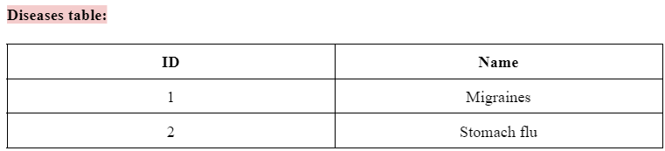
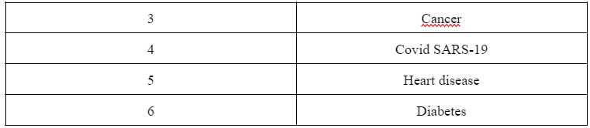
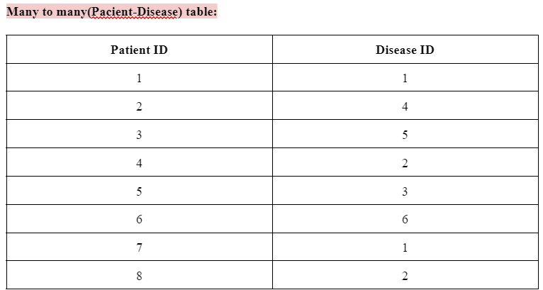

Slide 21
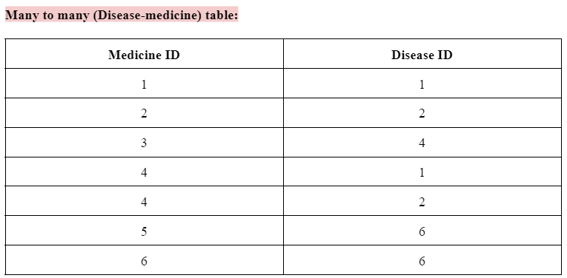
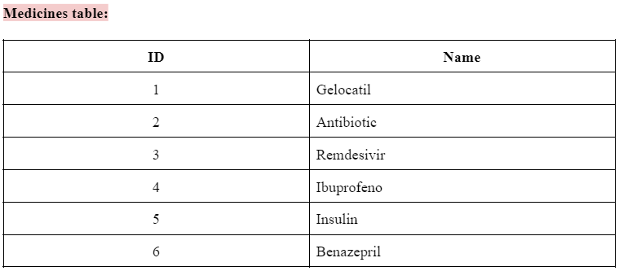

Slide 22
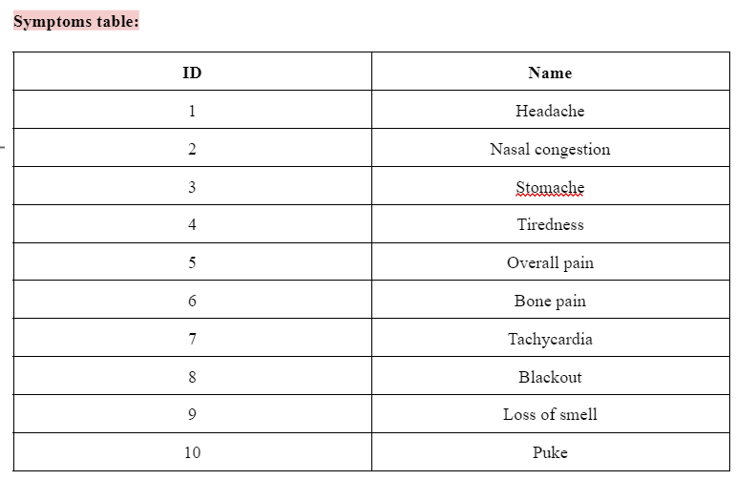
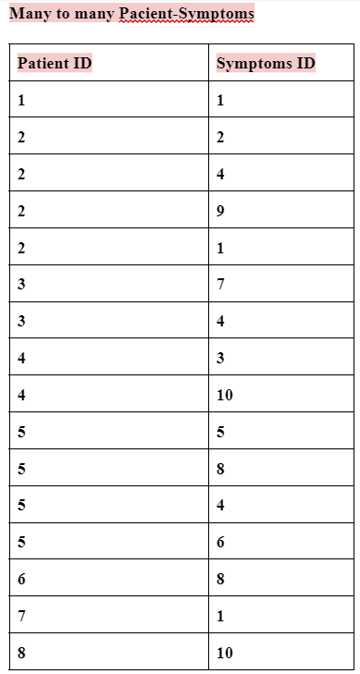

Slide 23
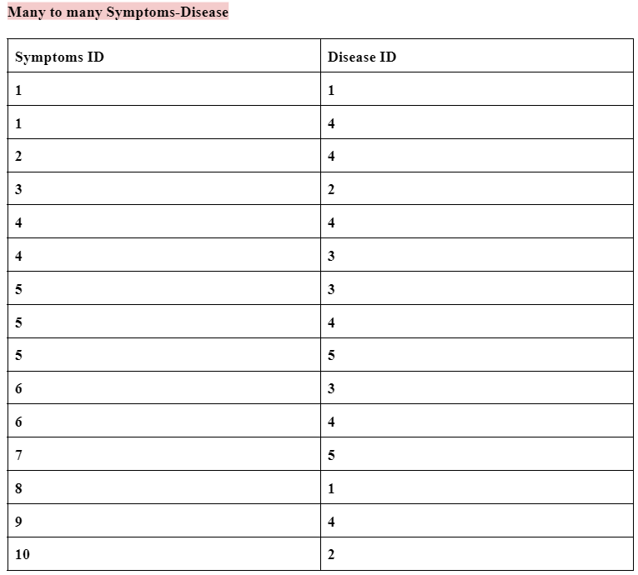
MANY TO MANY RELATIONSHIPS

Slide 24
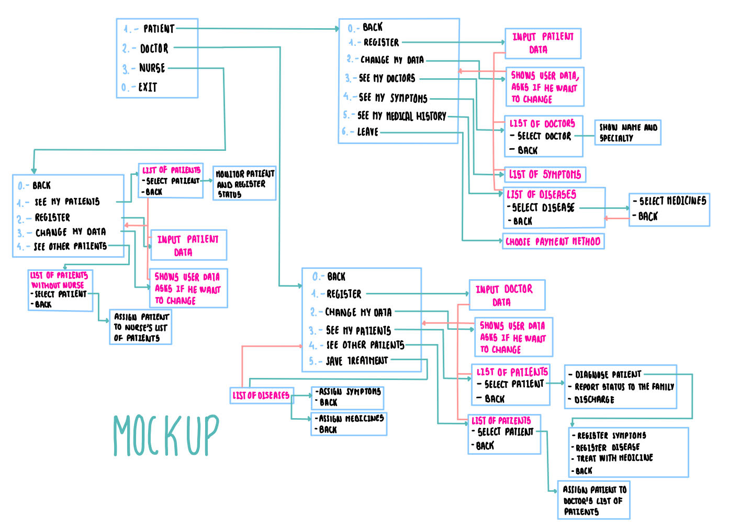
Kliknij, aby dodać tekst

Slide 25
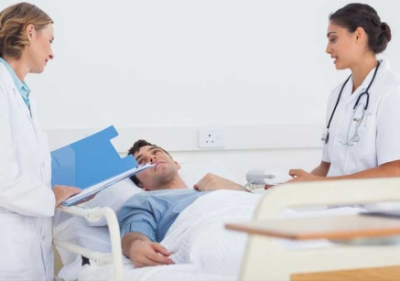
0. Back
Register
Change my data
See my doctors
See my medical history
Leave
PATIENT

Slide 26

0. Back
Register
Change my data
See my patients
See other patients
Save treatmentc
DOCTOR
Diagnose patient
Report status to family
Discharge

Slide 27

0. Back
Register
Change my data
See other patients
See my patients
NURSE
Register status

Slide 28



Conclusion
Patient care
Efficiency
Organization

Slide 29


Thanks for your attention

